Slide 1
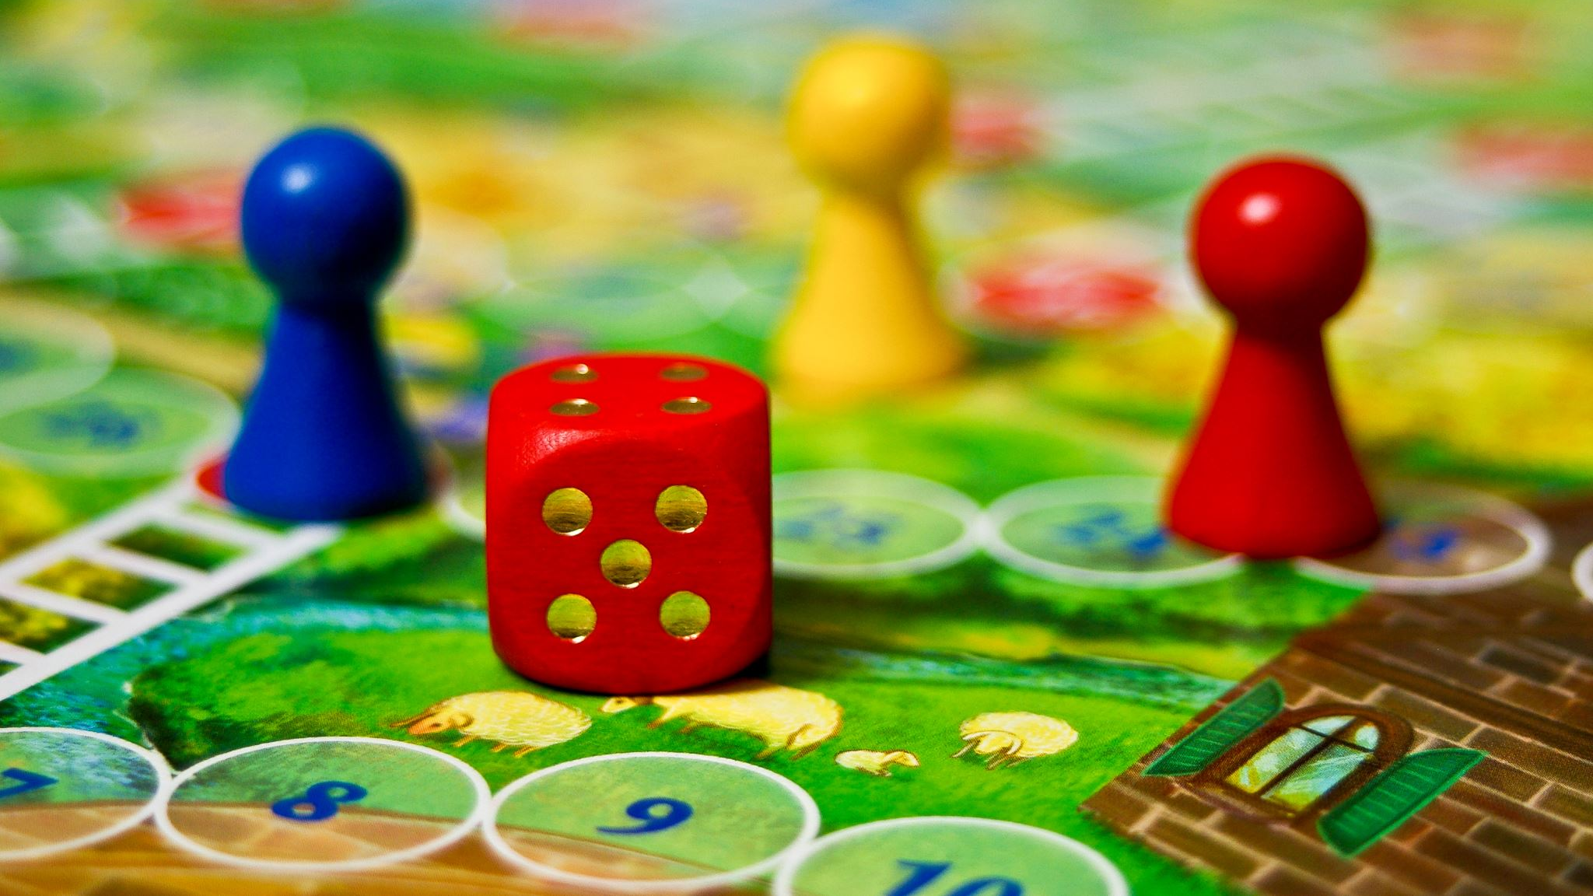
Minesweeper game

Slide 2
Game overview
  Mines are scattered throughout a board which is divided into cells.
  Cells have three states: unopened, opened and flagged.
  An unopened cell is blank and clickable, while an opened cell is exposed.
  Flagged cells are those marked by the player to indicate a potential mine location.
A player selects a cell to open it. If a player opens a cell with a mine, the game ends.
If player opens cell with a number, the number indicates of mines adjacent to it.
If player opens blank tile , then adjacent non-mined cells will be automatically opened.

Slide 3
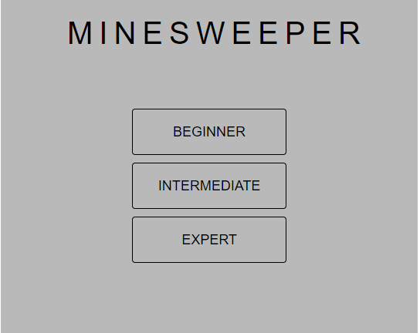
Demo – First state
Allows user select level of difficulty
Levels vary by board size and number of mine on them.
Beginner board is 9X9 with 10 mines
Intermediate board is 16 X16 with 40 mines
Expert board is 20X20 with 99 mines

Slide 4
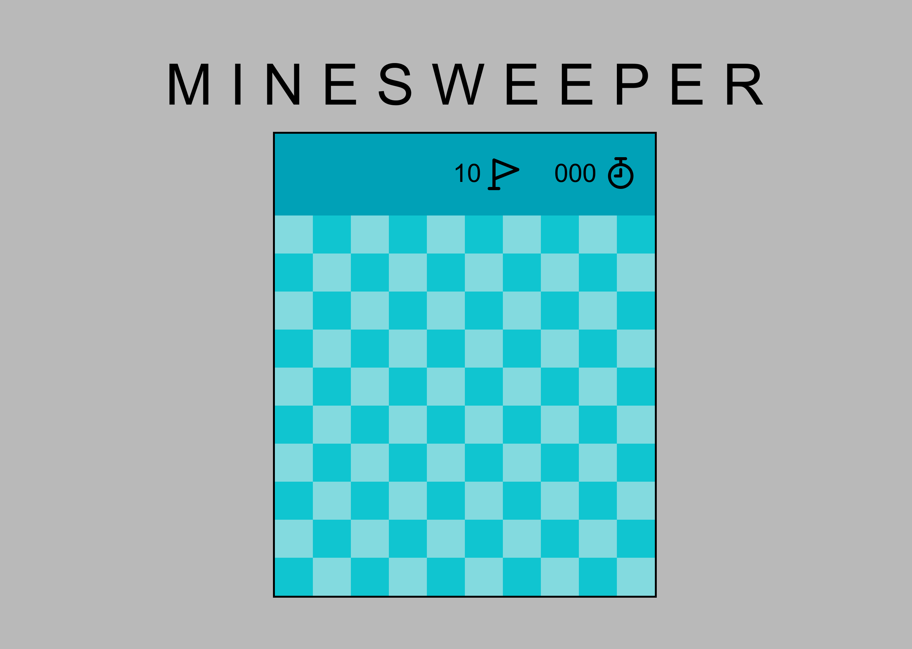
Demo -Second state
Initial state of the game after user select a level of difficulty
User can select any cell which starts a game and a timer
Player can open a cell with a left click or place a flag with a right click (MouseEvent.button will be used to differentiate clicks)
Number of remain flags is displayed in a header

Slide 5
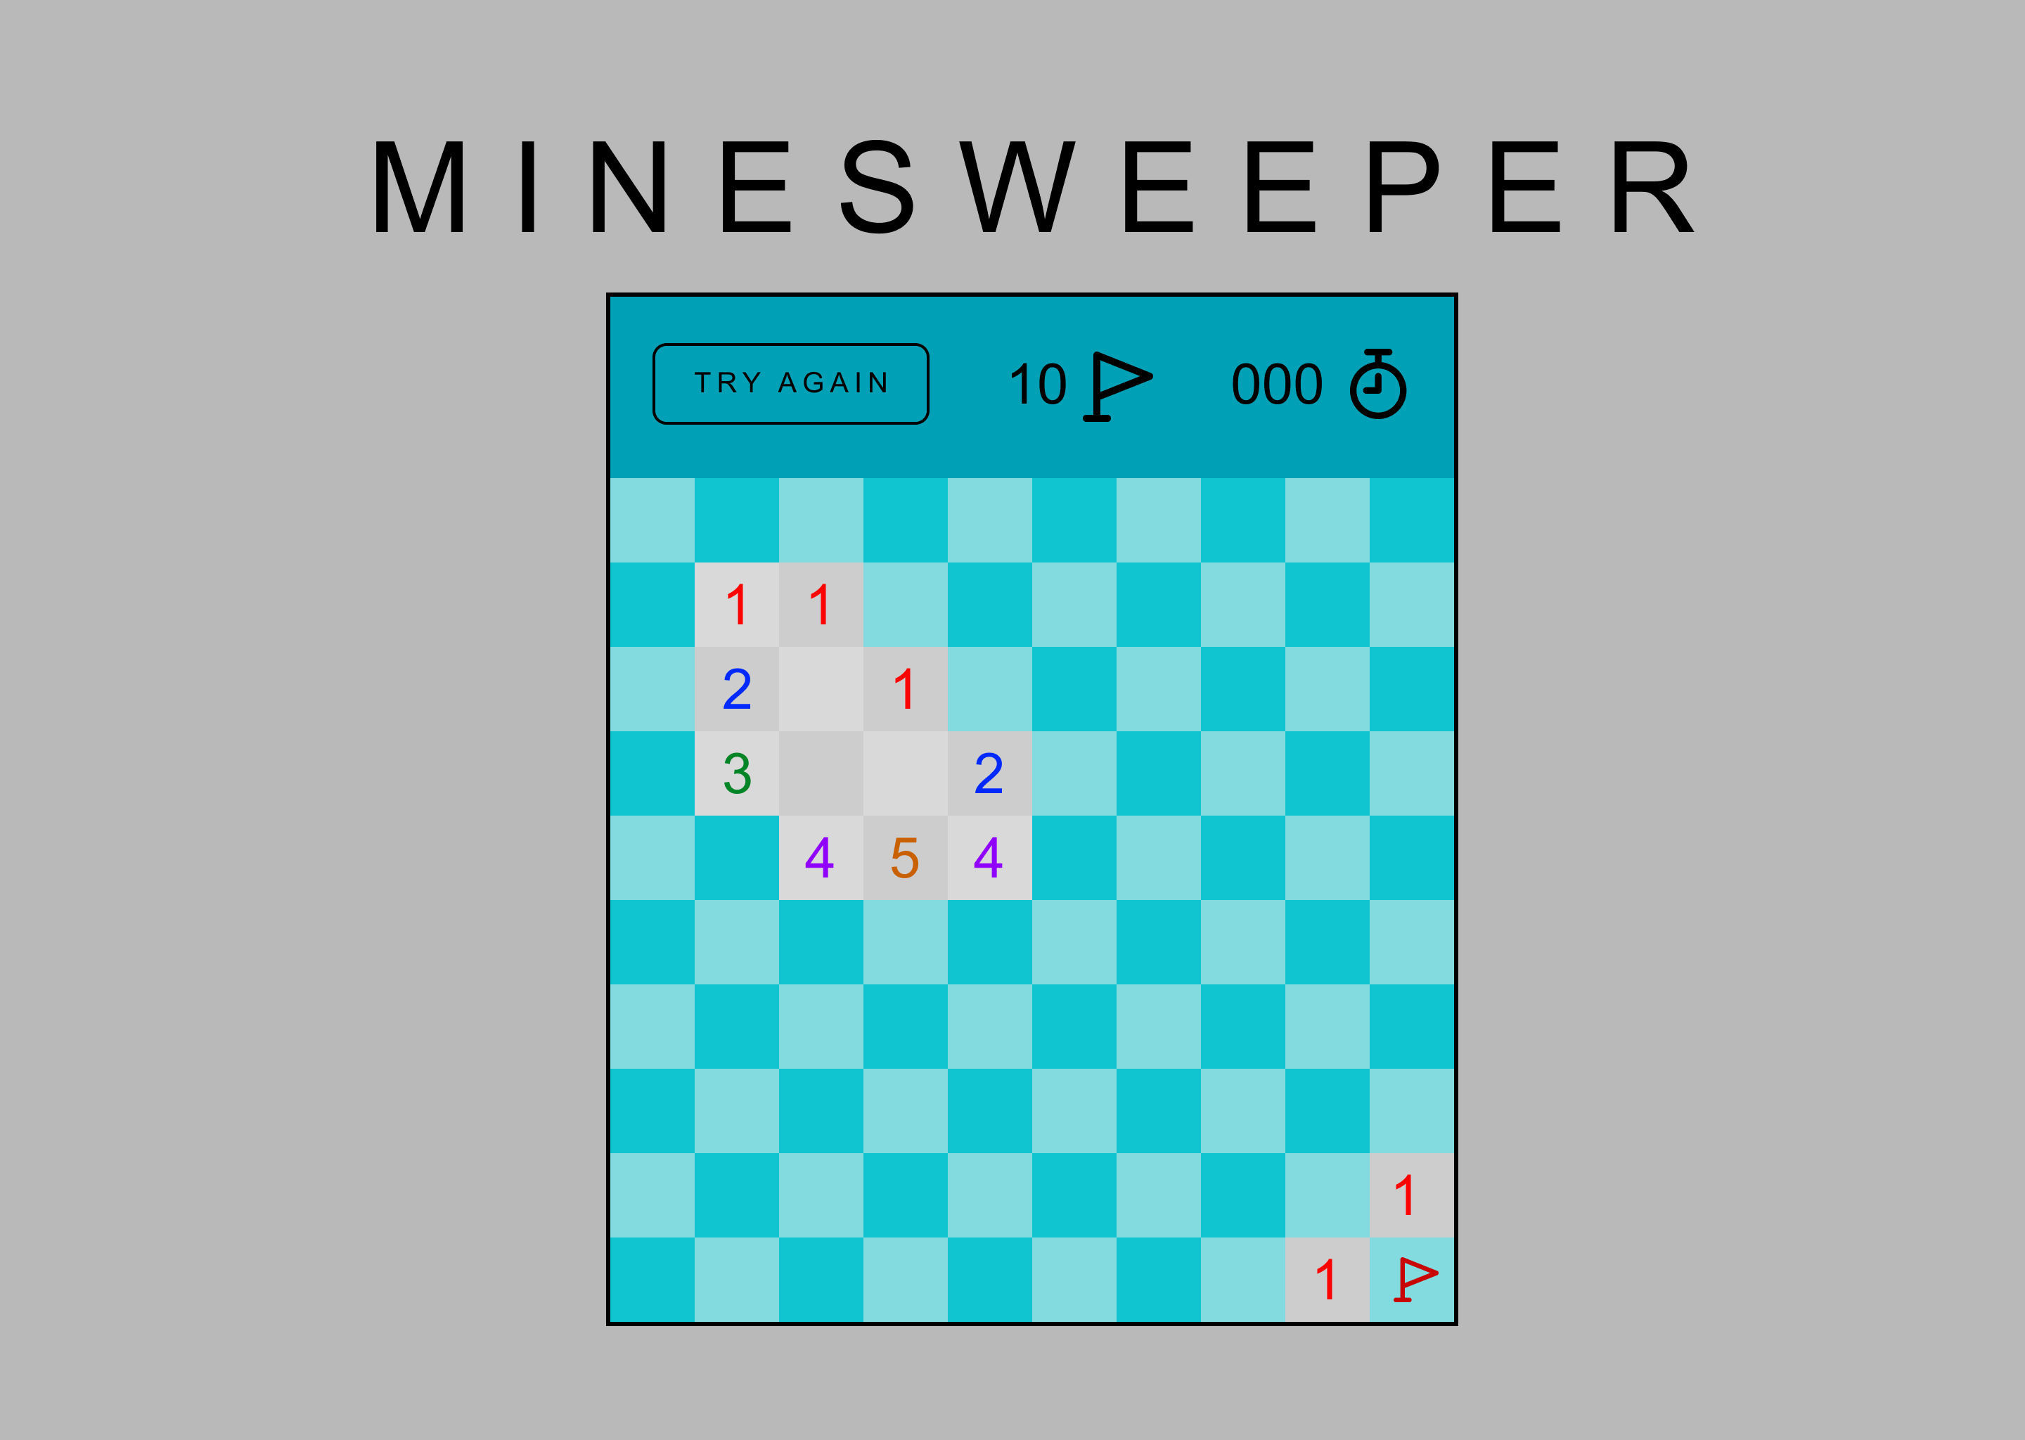
Demo –Third state
New game (‘Try again’) button appears in a header when player starts the game
Opened tiles change color from blue to gray.
Number of flags will decrement every time user use it.
Clock runs until player wins or looses.

Slide 6
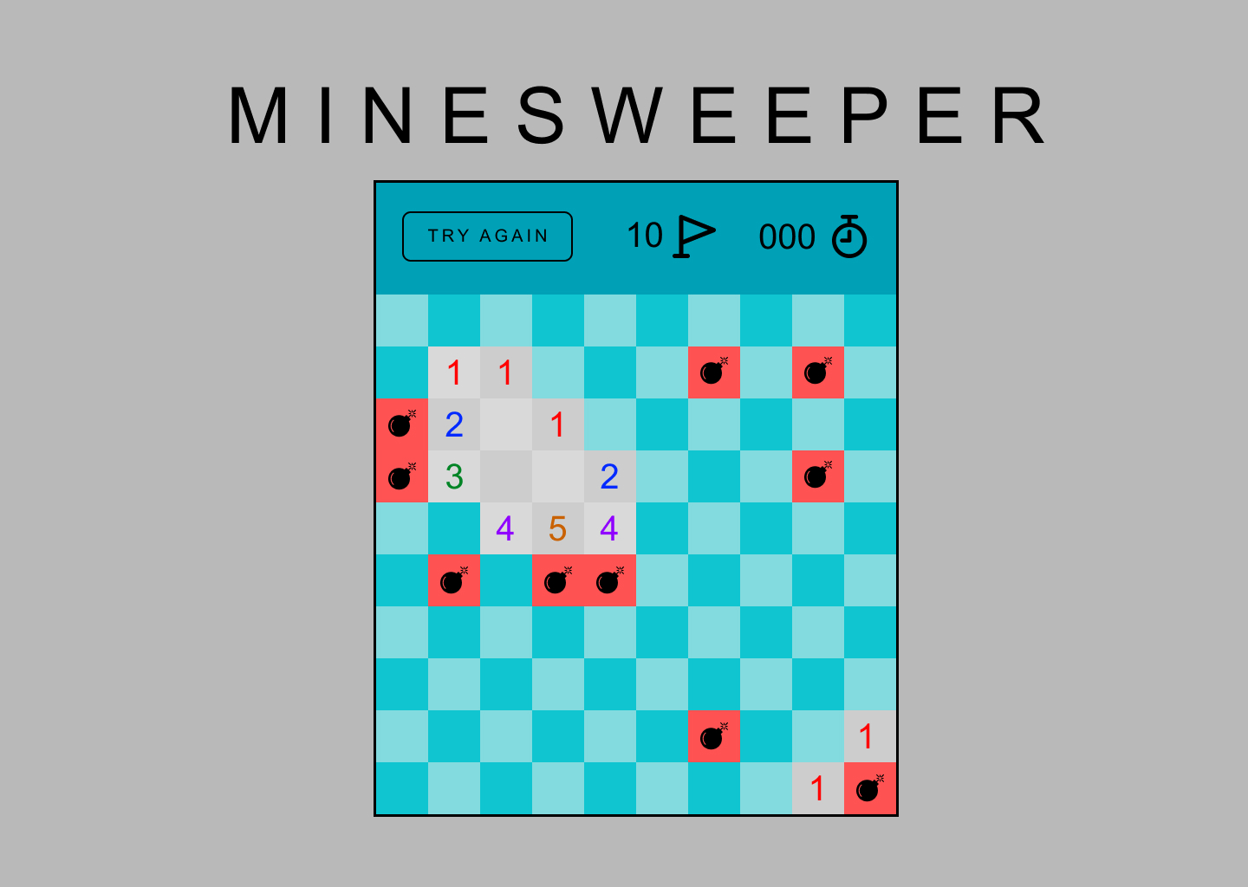
Demo – Last state
If user selects a cell with a mine , all mines pop indicating the end of the game.
User can restart the game pressing ‘TRY AGAIN’ button

Slide 7
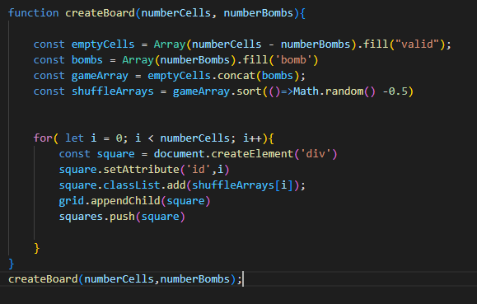
Completed work
Research on DOM manipulation
Complete user interface mockup
First state of the game:
HTML and CSS representation
Added functions for the buttons to set up the difficulty level
Second state of the game:
Set up a board with 100-400 cells
Generated 10-99 mines and randomly distributed within a board
Set up flags count
Added MouseEvent listener
Code

Slide 8
Features will be completed
Finish game functionality
Add number to cells around mines
Add clock functionality
Add game reset functionality
More CSS Styling
Refactoring

